Slide 1
High Performance Spatial Queries and Analytics for 3D Spatial Data
Yanhui Liang
Department of Biomedical Informatics
Department of Computer Science
Advisor: Fusheng Wang
February 17, 2017

Slide 2
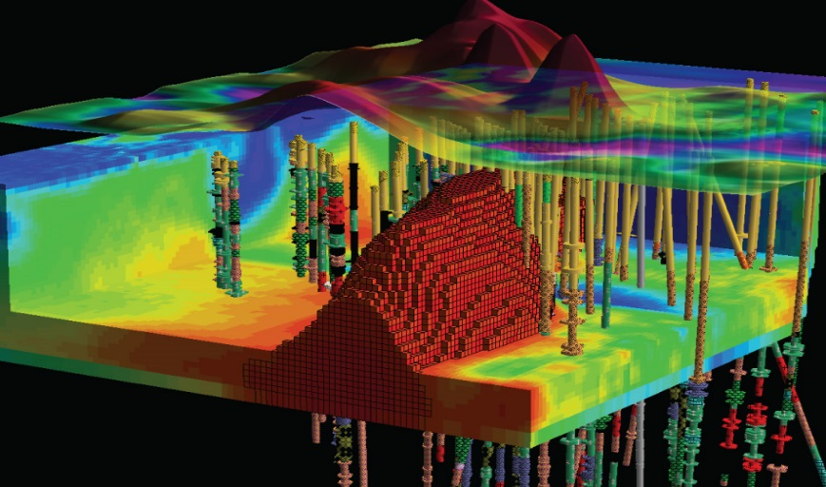
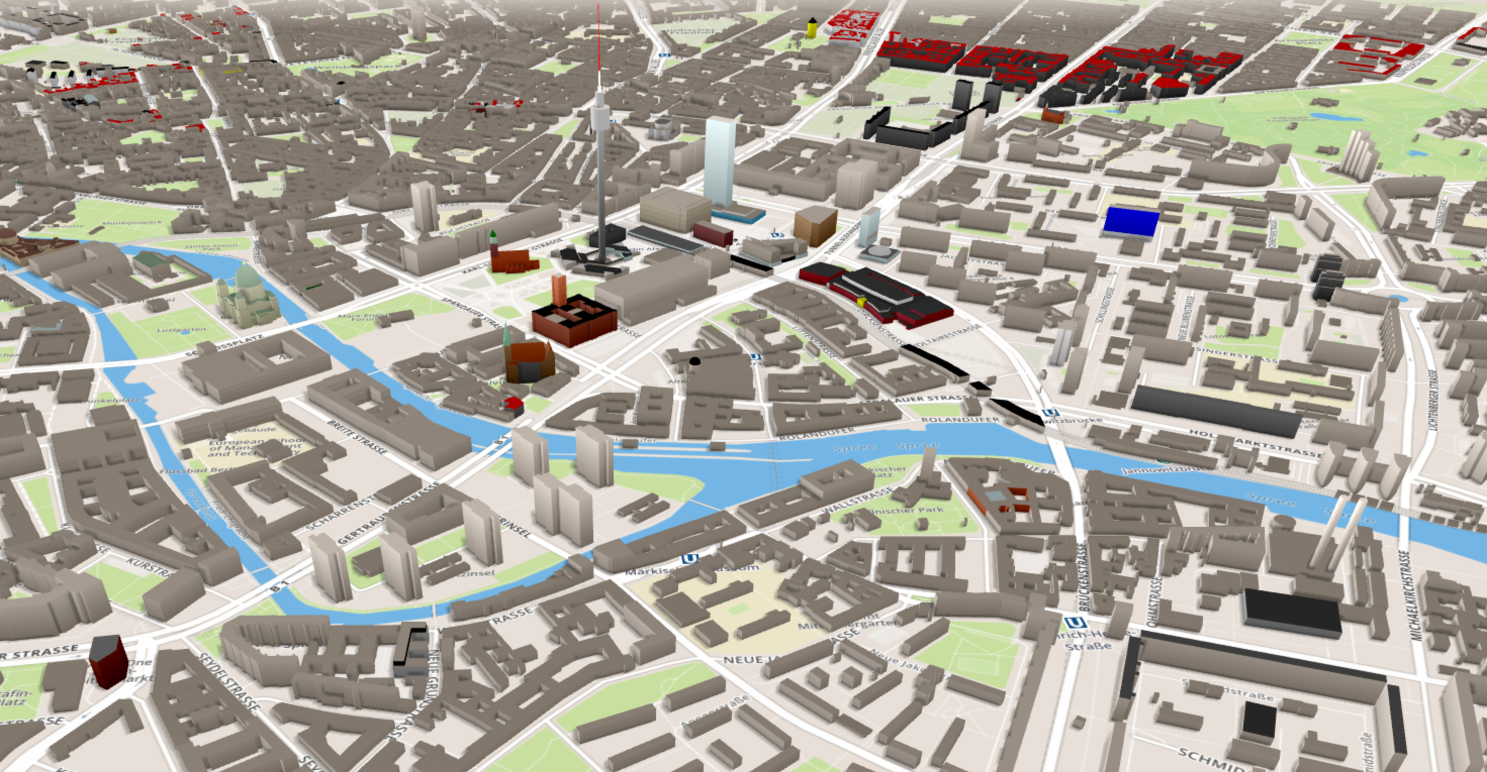
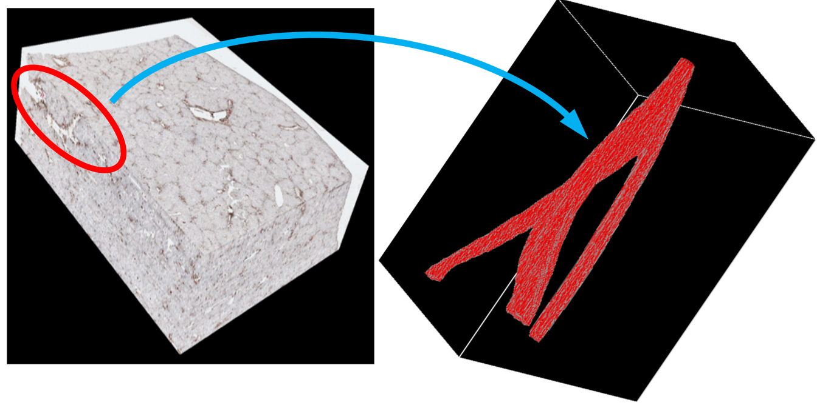
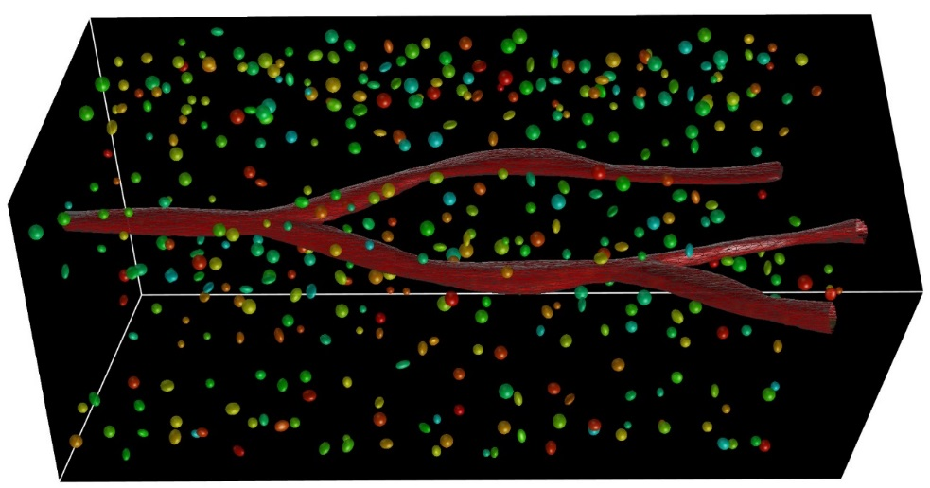
3D Spatial Data
3D Mining and Exploration
3D City Modelling and Planning
3D Pathology Imaging
3D Blood Vessel and Nuclei
Introduction
Notes:
Recently, more and more 3D spatial data are produced in both industry applications and scientic research
3d mining and exploration industry, 3D geoscience data
3D buildings in 3D city modelling and planning
3d pathology imaging, more and more micro-anatomic objects, like blood vessels and nuclei
Spatial data is exploding with cost effective and ubiquitous positioning technologies
Location based services through GPS and smart phones
Geo-crowdsourcing: OpenStreetMap
An open map of the world
Users can quickly input data
1 million users and more than 600,000 contributors
Two billion nodes; data increases at a dramatic speed
Scientific spatial applications are increasingly data- and compute- intensive
High-resolution instruments are generating fine resolution images and sensing data:
--- High resolution remote sensing instruments
--- High resolution image scanners for human tissues
e.g.: digital pathology imaging (an emerging field) provides high resolution images of microanatomic structures, such as nuclei, blood vessels, and bile ducts
And 3D digital pathology imaging is possible (with stacking of sectioned multiple slides)
Spatial data exploration involves massive number of spatial objects, and is highly data- and compute-intensive

Slide 3
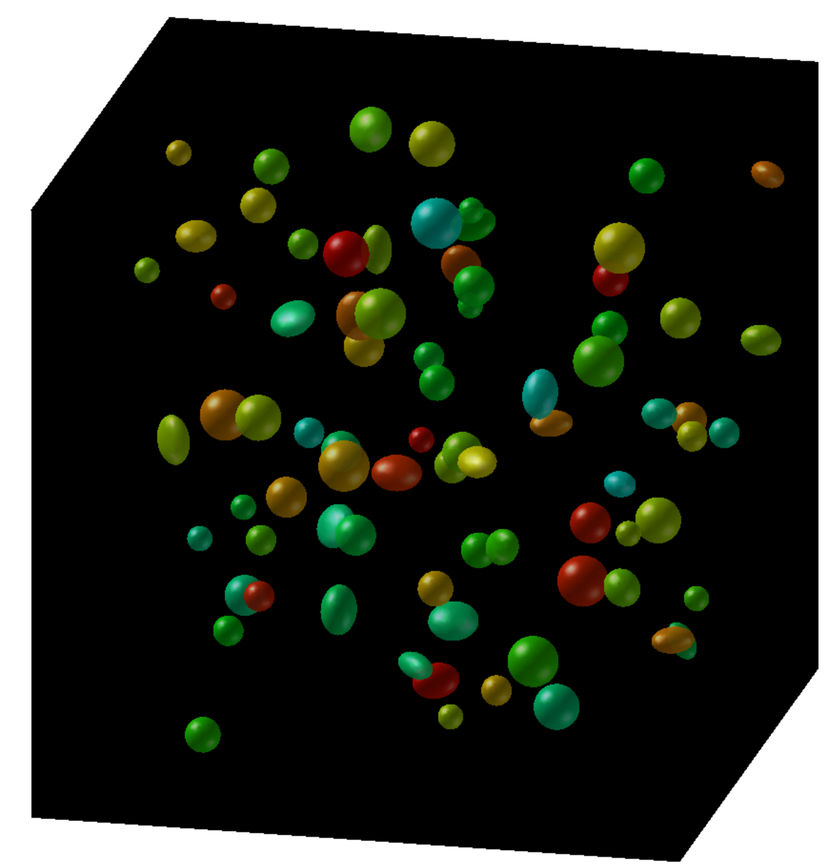
Systematic Image Algorithm Evaluation
High quality image analysis algorithms are essential to support biomedical research and diagnosis
Validate algorithms with human annotations
Compare and consolidate different algorithm results
e.g.: what are the distances and overlap ratios between markup boundaries from two algorithms?
Cross matching of two spatial data sets
Green: algorithm 1
Red: algorithm 2
Introduction
Notes:
Spatial join/spatial overlay/spatial cross-matching

Slide 4
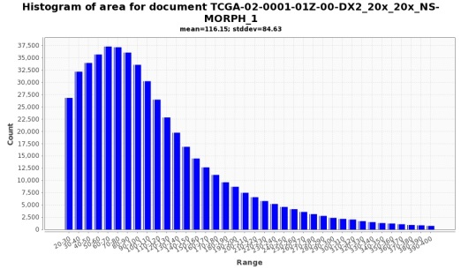
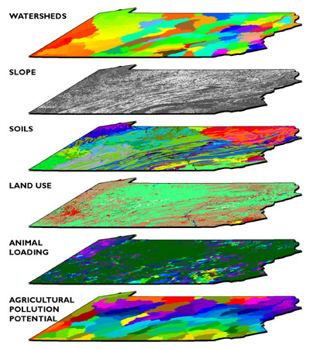
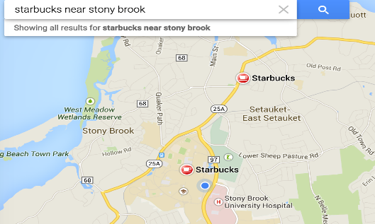
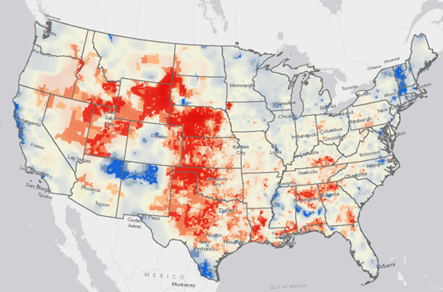
Spatial Queries and Analytics
Feature based descriptive queries
Feature based filtering or feature aggregation
Spatial relationship based queries
Spatial join (two- or multi-), window, point-query
Distance based queries
Nearest neighbors
Spatial proximity estimation
Spatial analytics
Find spatial clusters, hotspots, and anomalies
Introduction
Notes:
Spatial data exploration (and analytics) comes with many forms, including feature based queries, spatial relationship based queries, distance based queries, and complex spatial analytics.
In this paper, we mainly focus on spatial relationship based queries, including spatial joins: two-way and multi-way joins, window based queries and point-in-polygon queries. A special case of spatial join is polygon overlay or spatial cross-matching queries.
Spatial cross-matching is to identify and compare derived spatial objects belonging to different analyses or measurements. Such query could involve large number of spatial objects to compare and are highly expensive to process.

Slide 5
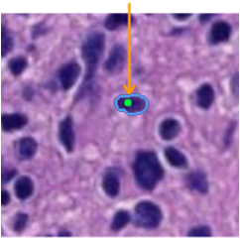
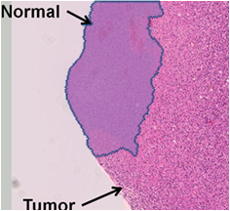
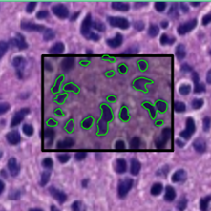
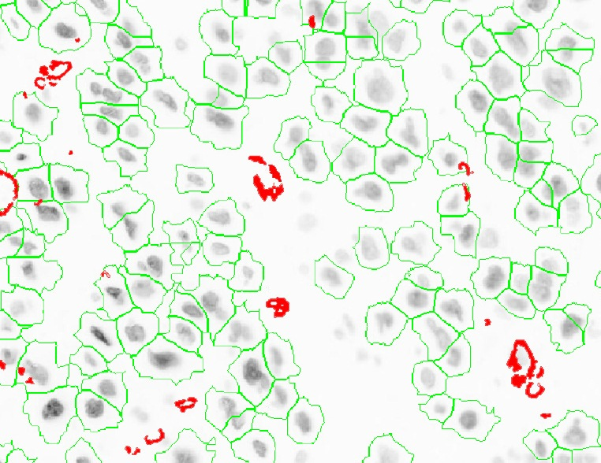
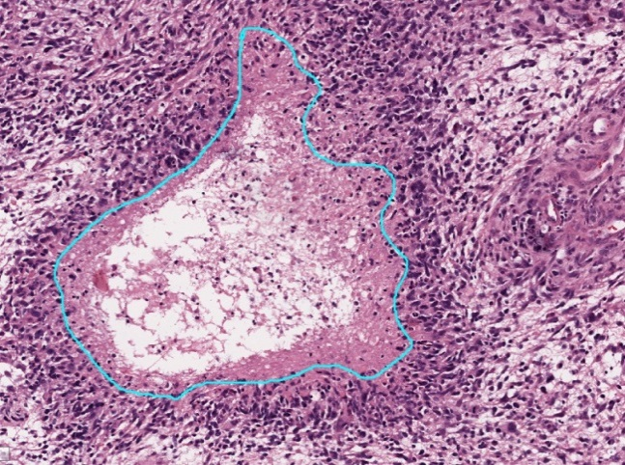
“GIS” Centric Queries for Pathology Data
POINT
CONTAINMENT
WINDOW
SPATIAL JOIN
NEAREST NEIGHBOR
DENSITY
Introduction

Slide 6
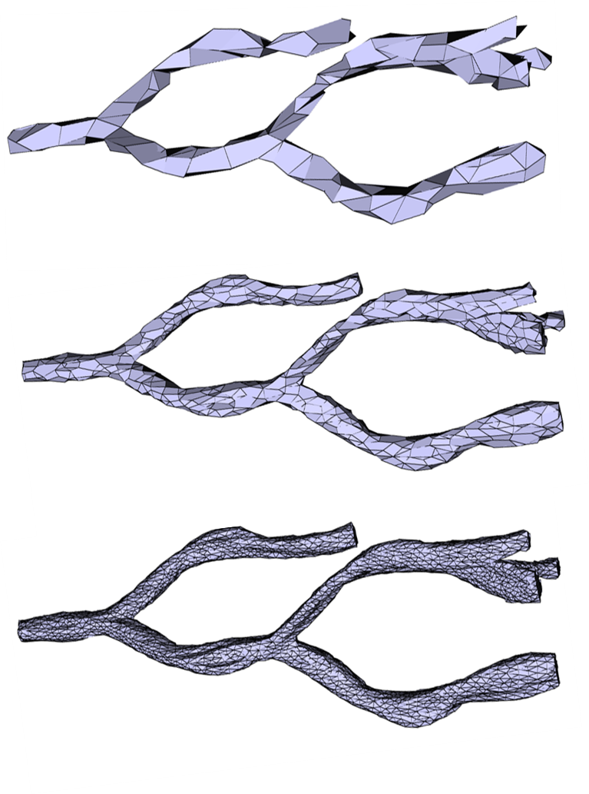
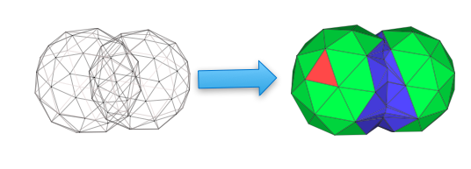
Requirements and Challenges
Explosion of 3D data
10 billion pixels per image, hundreds of slides per volume, tens of millions of 3D objects per volume
3D complex structures and representations
Bifurcations and branches in blood vessel
Multiple Levels of Detail (LOD)
High computational complexity
Heavy duty geometric computations
Introduction
Notes:
10 billion pixels
1 million markups, 100 million features
Quadrillion pixels
10 trillion features

Slide 7
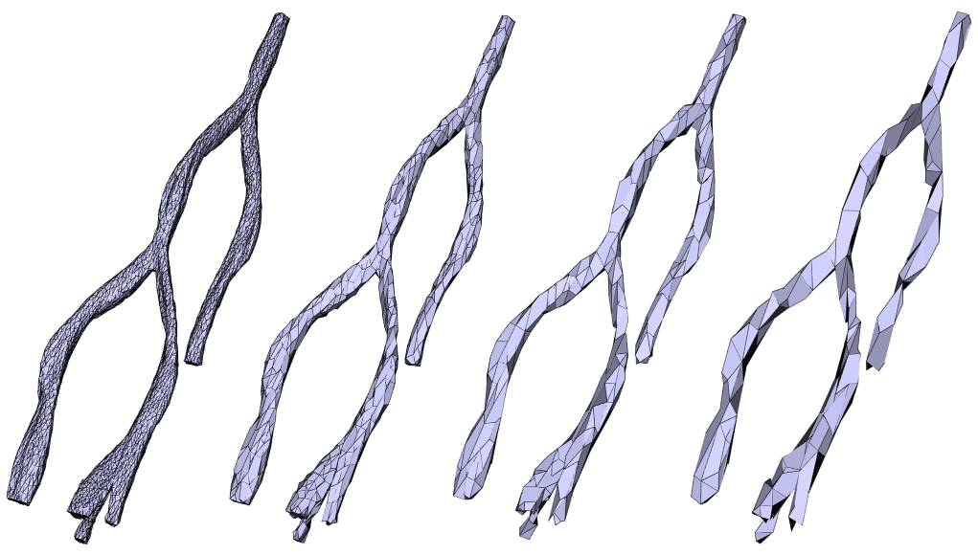
Challenges
Fig. 1: A pathology image volume with one reconstructed 3D blood vessel
Fig. 2: Intersection volume computation
Fig. 3: Multiple LODs
Introduction
Notes:
Instead, we develop a system called Hadoop-GIS, and provide a generic framework to support
high performance spatial queries and analytics for spatial big data on MapReduce and CPU-GPU hybrid systems.
Hadoop-GIS provides:
…

Slide 8
Our Approach: Hadoop-GIS 3D
A general framework to support high performance spatial queries and analytics for 3D spatial big data on MapReduce
3D mesh compression
In-memory data storage
Multi-level spatial indexing
On-demand spatial query engine
Data skew aware spatial data partitioning
Boundary objects handling
Hadoop-GIS 3D
Notes:
Instead, we develop a system called Hadoop-GIS, and provide a generic framework to support
high performance spatial queries and analytics for spatial big data on MapReduce and CPU-GPU hybrid systems.
Hadoop-GIS provides:
…

Slide 9
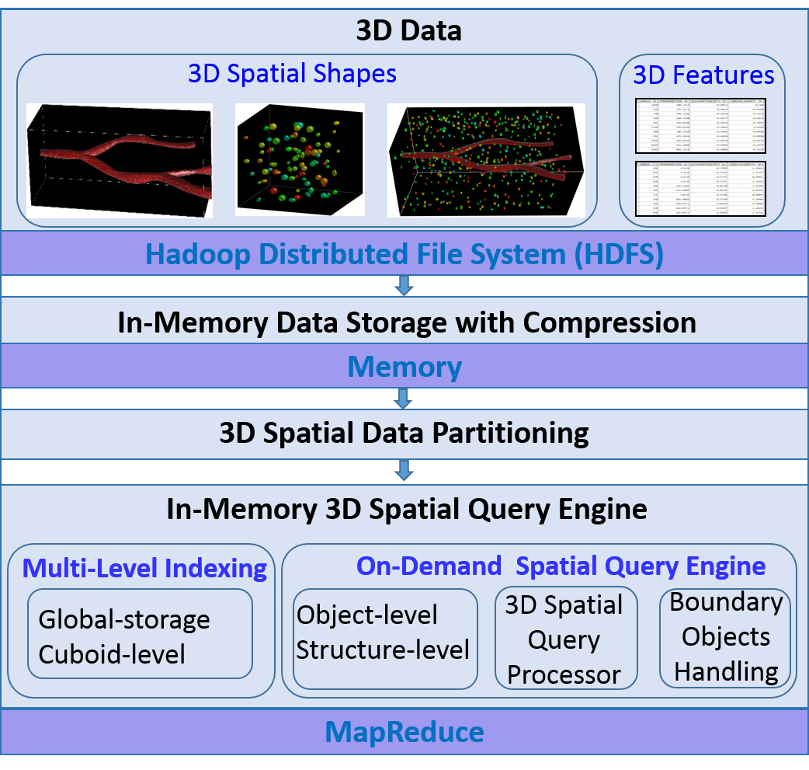
Hadoop-GIS 3D Architecture
Hadoop-GIS 3D
Notes:
Hadoop-GIS provides an end-to-end solution:
A spatial query language based on SQL (Hive QL);
A query translation engine from SQL to MapReduce;
Spatial queries will run on based on the Haoop-GIS query engine; traditional structural queries run on Hive.
A parallel data partitioning tool based on MapReduce is being developed.

Slide 10
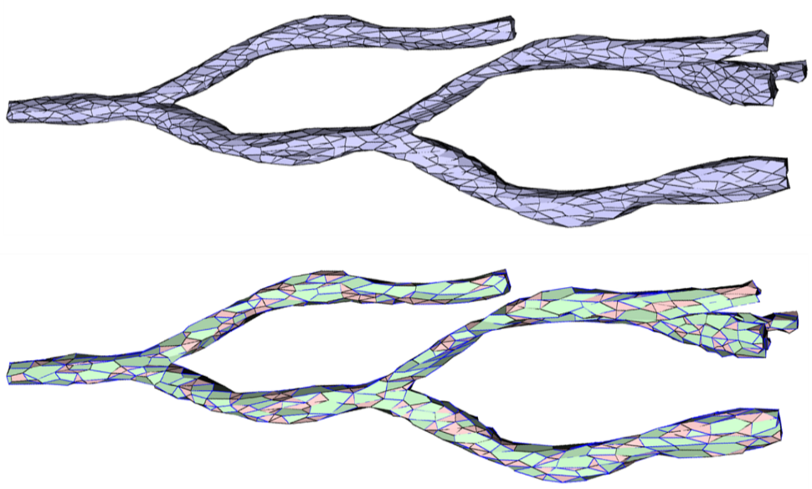
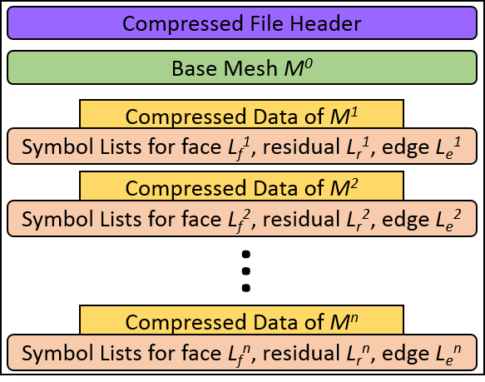
3D Data Compression
An progressive approach consists of three steps
Decimation: remove vertices and add edges
Patch and edge encoding: generate symbol lists
Entropy Coding: further compress the symbol lists
Compressed file size
Base mesh: 1%, compressed file: 3%
Time complexity: linear with the # of vertices
Mesh decimation
Compressed mesh file structure
Hadoop-GIS 3D
Notes:
To efficiently handle certain spatial queries, the system also provides multi-level indexing support.
Tile based indexing for query processing and filtering.
Region based indexing for batch-processing based query optimization and filtering.

Slide 11
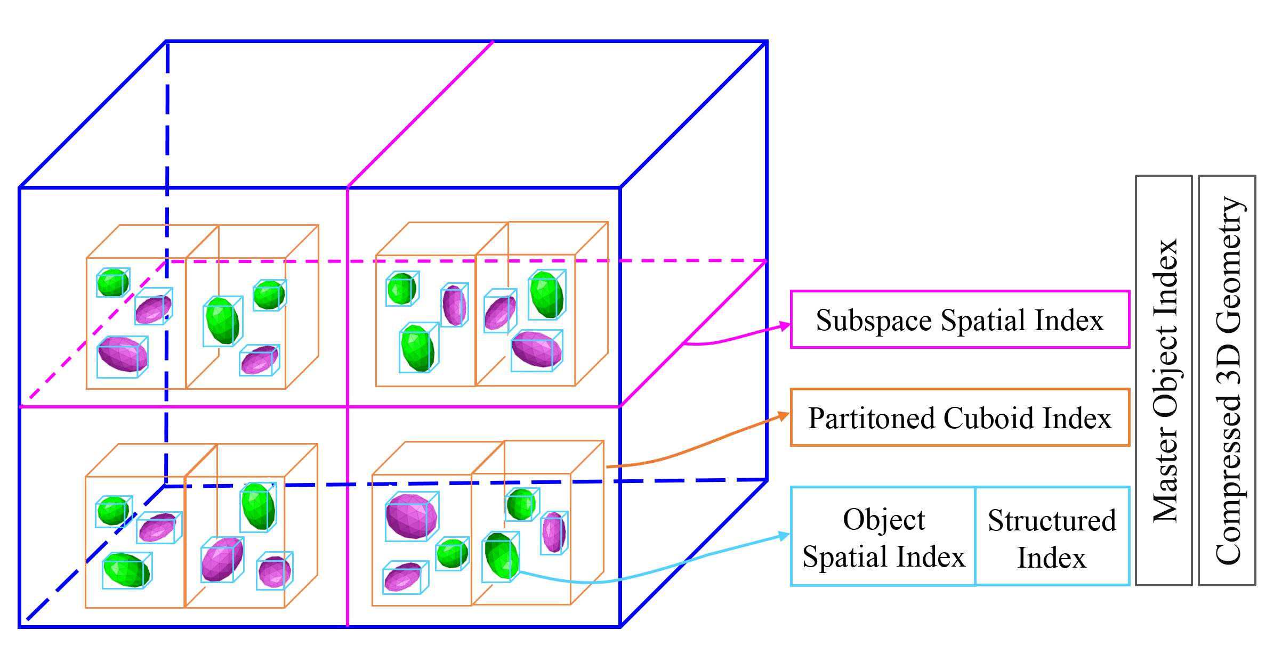
Multi-level Spatial Indexing
Subspace based spatial indexing for grouping multiple neighboring cuboids: filtering data
Cuboid indexing for managing cuboids: filtering tasks in mapping stage
Hadoop-GIS 3D
Notes:
To efficiently handle certain spatial queries, the system also provides multi-level indexing support.
Tile based indexing for query processing and filtering.
Region based indexing for batch-processing based query optimization and filtering.

Slide 12
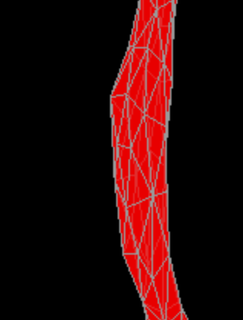
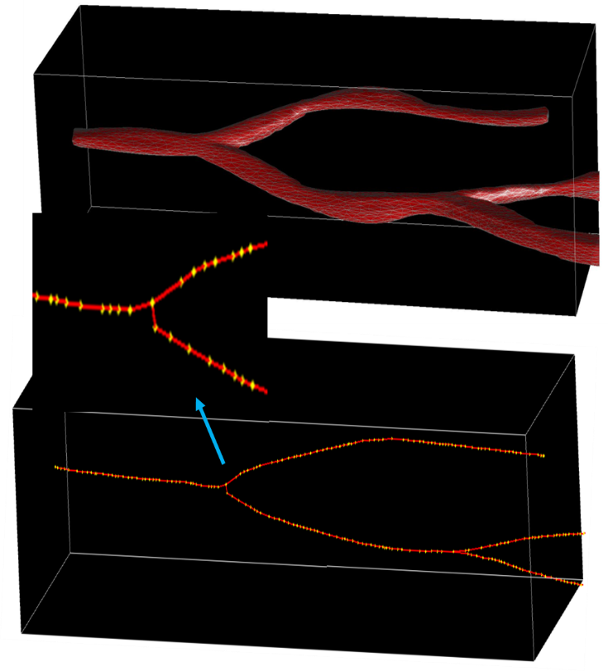
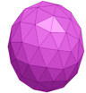

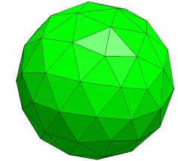
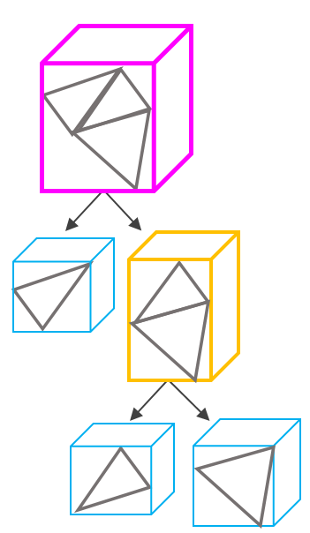
Multi-level Spatial Indexing
On demand indexing for intra-cuboid object queries
Structural indexing for speeding up 3D object primitives traversal
Intra-cuboid indexing
Structural indexing
Hadoop-GIS 3D
Notes:
To efficiently handle certain spatial queries, the system also provides multi-level indexing support.
Tile based indexing for query processing and filtering.
Region based indexing for batch-processing based query optimization and filtering.

Slide 13
A General Framework of 3D Spatial Data Processing in MapReduce
A. Raw data staging on HDFS
B. Data compression
C. Spatial partitioning
D. Block based filtering with global indexes
E. For each cuboid in input_collection do (in parallel)
Cuboid based filtering based on cuboid indexes
On-demand indexing for objects in the cuboid
Cuboid based spatial query processing
F. Boundary-crossing object handling
G. Post-query processing
H. Result storage on HDFS
Hadoop-GIS 3D
Notes:
Hadoop-GIS (is based on ) comes with a general framework for spatial data processing in MapReduce to support multi-types of spatial queries and analytics, summarized in following steps.
Data is partitioned and staged to HDFS.
Pre-Processing
Block based
Tile based spatial query processing
Boundary processing
Post-Processing

Slide 14


Example: 3D Spatial Join in MapReduce: Data Compression and Partitioning
3D Objects
HDFS
HDFS
Partitioning
MBB
MBB Partitioning & Indexing
Data staging
Data Compression
Geometry
Memory
Spatial Query Processing with MapReduce
Notes:
Staging: result files redistributed across HDFS as blocks
Global indexing created
Map: identify records of same tiles to form tasks
Reduce: execute queries with real-time spatial query engine
Boundary normalization: another MapReduce
Aggregation: aggregate query results

Slide 15


Example: 3D Spatial Join in MapReduce: Query Processing
…
…
Data Scan
Data Scan
Data Scan
MAP: group objects by cuboids (keys)
Spatial join
…
REDUCE: one query engine per cuboid
Spatial Query Processing with MapReduce
Notes:
Staging: result files redistributed across HDFS as blocks
Global indexing created
Map: identify records of same tiles to form tasks
Reduce: execute queries with real-time spatial query engine
Boundary normalization: another MapReduce
Aggregation: aggregate query results

Slide 16
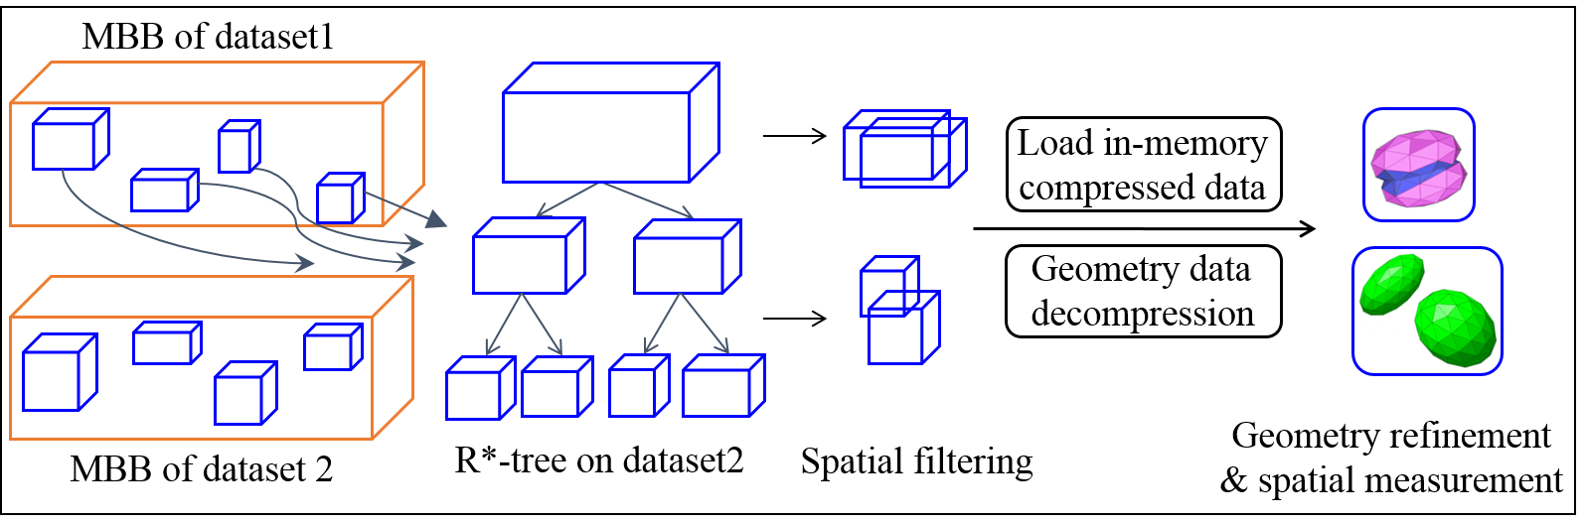
Real-Time Spatial Query Engine (RESQUE)
Effective querying methods that can run in parallel in distributed computing environments
Spatial join, containment, nearest neighbor, and can be extended
Computational Geometry Algorithms Library (CGAL)
On-demand indexing based query processing
Create indexes on demand in memory
Indexing building overhead is a very small fraction
Spatial Query Processing with MapReduce
Notes:
The spatial operators are handled by an internal spatial query engine (RESQUE) which supports:
Efficient spatial access methods for query processing
Various spatial measurement operation and spatial functions

Slide 17
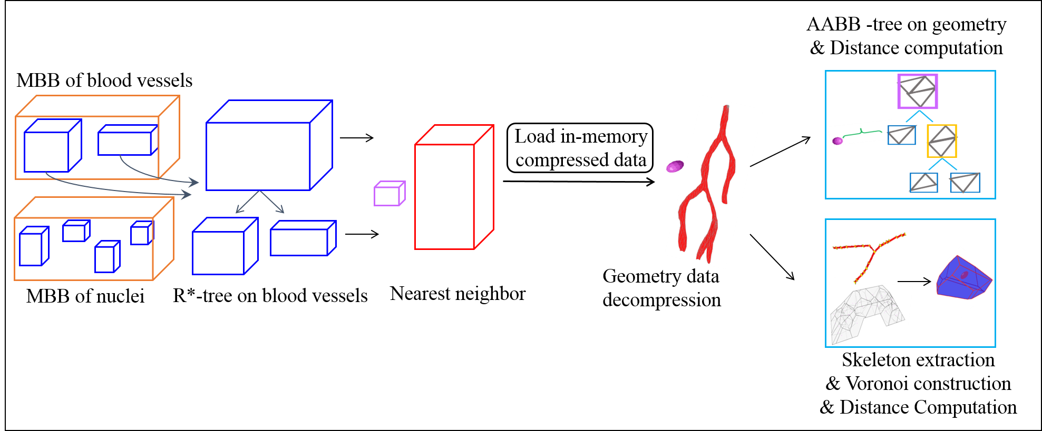
Real-Time Spatial Query Engine (RESQUE)
Nearest neighbor query
For example: for each cell find the closest blood vessel and return distance to that blood vessel
Structure-level index
AABB tree and skeleton for Voronoi
Spatial Query Processing with MapReduce
Notes:
The spatial operators are handled by an internal spatial query engine (RESQUE) which supports:
Efficient spatial access methods for query processing
Various spatial measurement operation and spatial functions

Slide 18
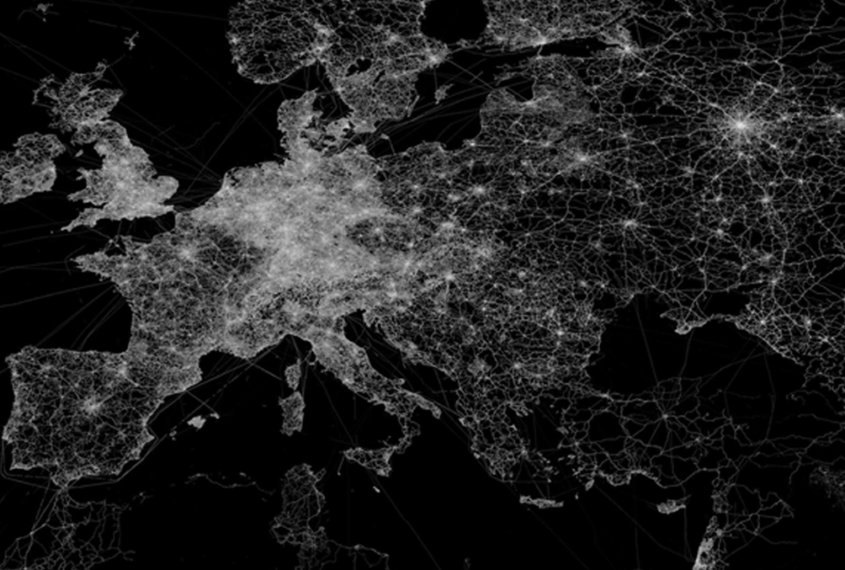
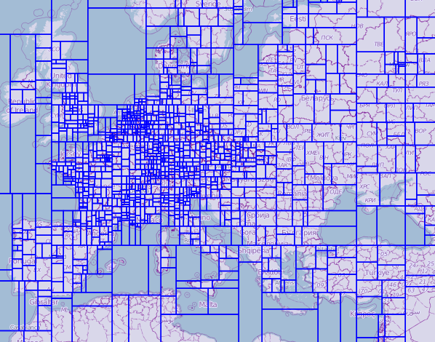
Spatial Partitioning
Effective partitioning is critical for task parallelization and load balancing: data skew
Criteria: balanced distribution, granularity, overlapping
Methods: top-down: recursive slicing; bottom-up: R-Tree packing
Parallezation with MapReduce
Spatial Partitioning

Slide 19

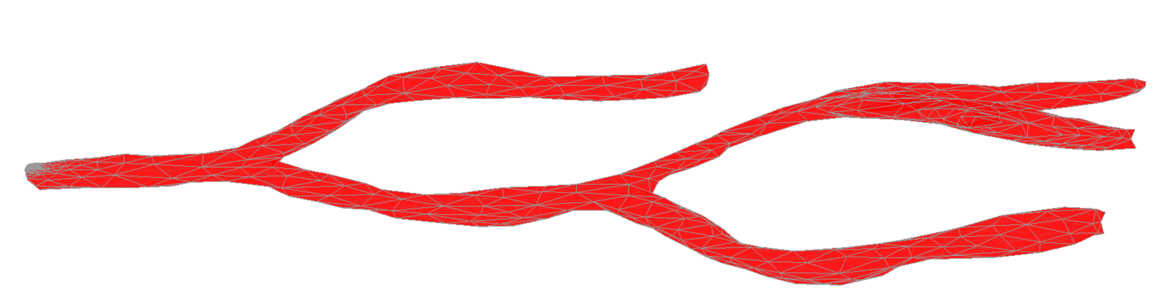





Boundary-Crossing Object Handling
“Multi-assignment, single-join”: replicate objects on boundaries to multiple tiles at partitioning
Normalization methods are provided for each query type to correct answers
Spatial join: removal of duplicates
Nearest neighbor
It always return correct nearest neighbors
Spatial Partitioning
Notes:
One major issue for spatial partitioning based query processing is the effect of boundary-crossing objects.
We take a multi-assignment based partitioning method, where objects crossing tile boundaries are replicated
across multi-tiles.
Normalization is provided as a post-processing step to amend partitioning effect.
(We will justify such design decision in later slides)

Slide 20
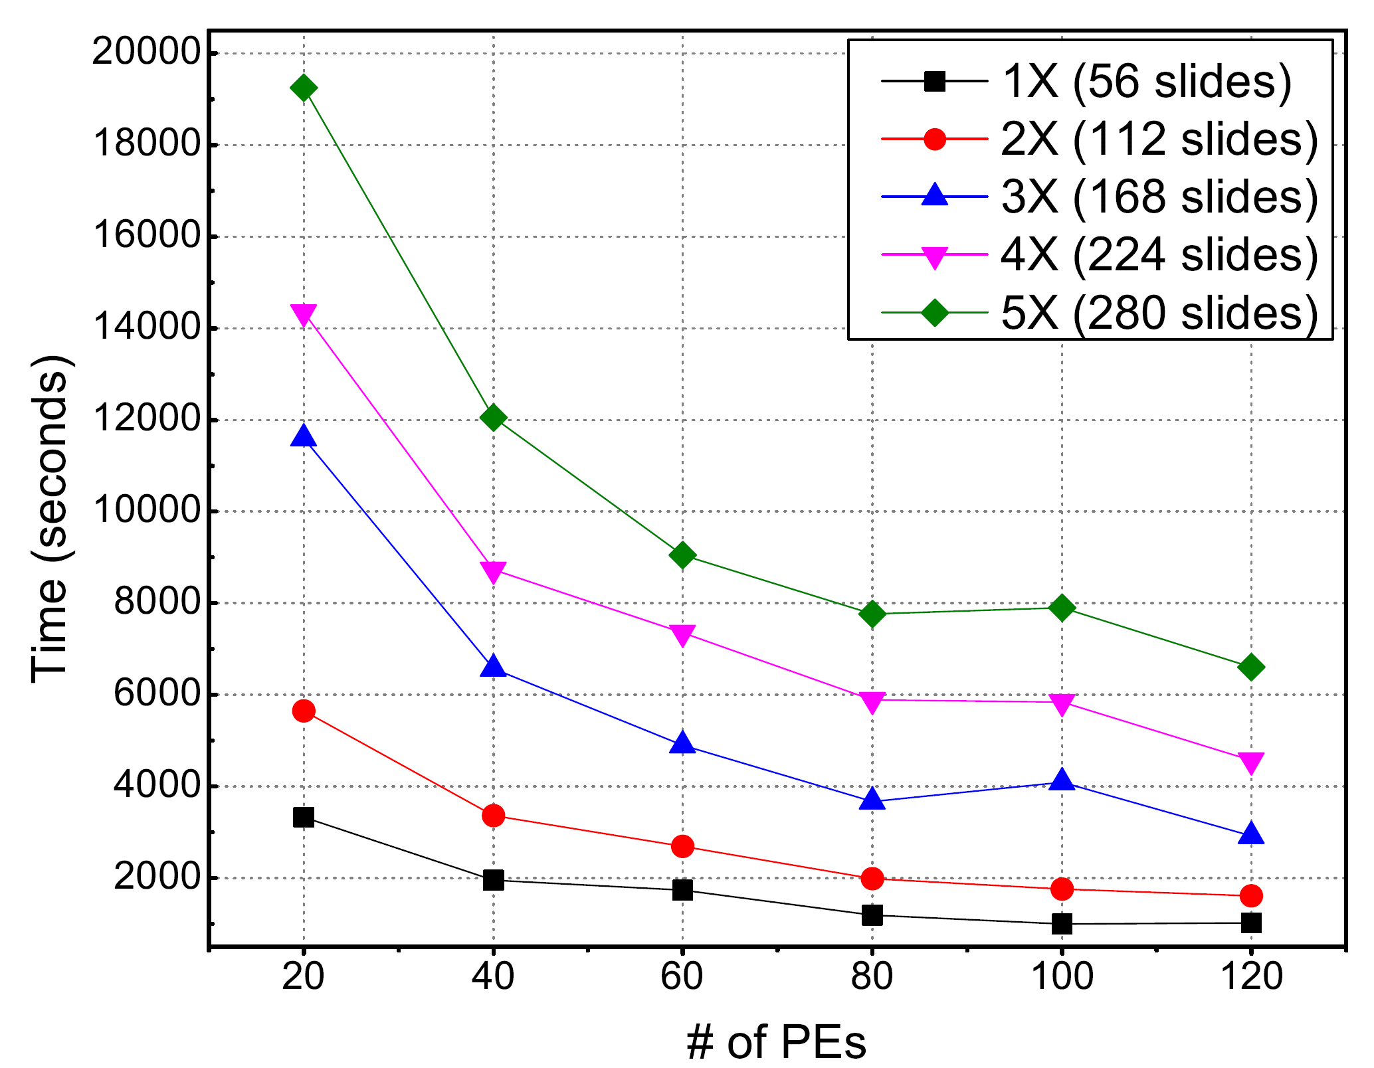
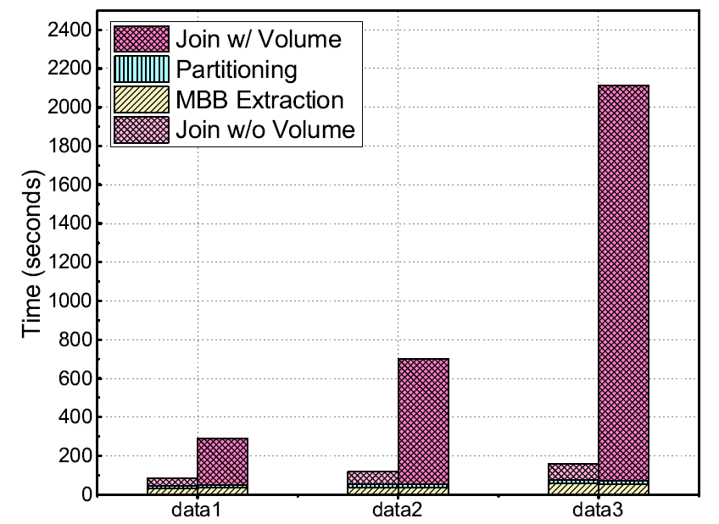
System Performance: Spatial Join
Spatial Join
Spatial Join with different LOD
Performance
Notes:
Hadoop-GIS shows nice scalability as well.
We see scalable query performance with increasing number of reducers, and increasing size
of datasets. The first one is for OpenStreetMap dataset, and the second one is for imaging data with
Datasets of different sizes.
The boundary normalization overhead is a small fixed fraction of the overall cost.
The average querying time per image is 15 seconds (with 1X dataset and all cores), comparing with 22 minutes 12 seconds in a single partition postGIS, and 89 minutes 30 seconds on a single partition SDBMS X.

Slide 21
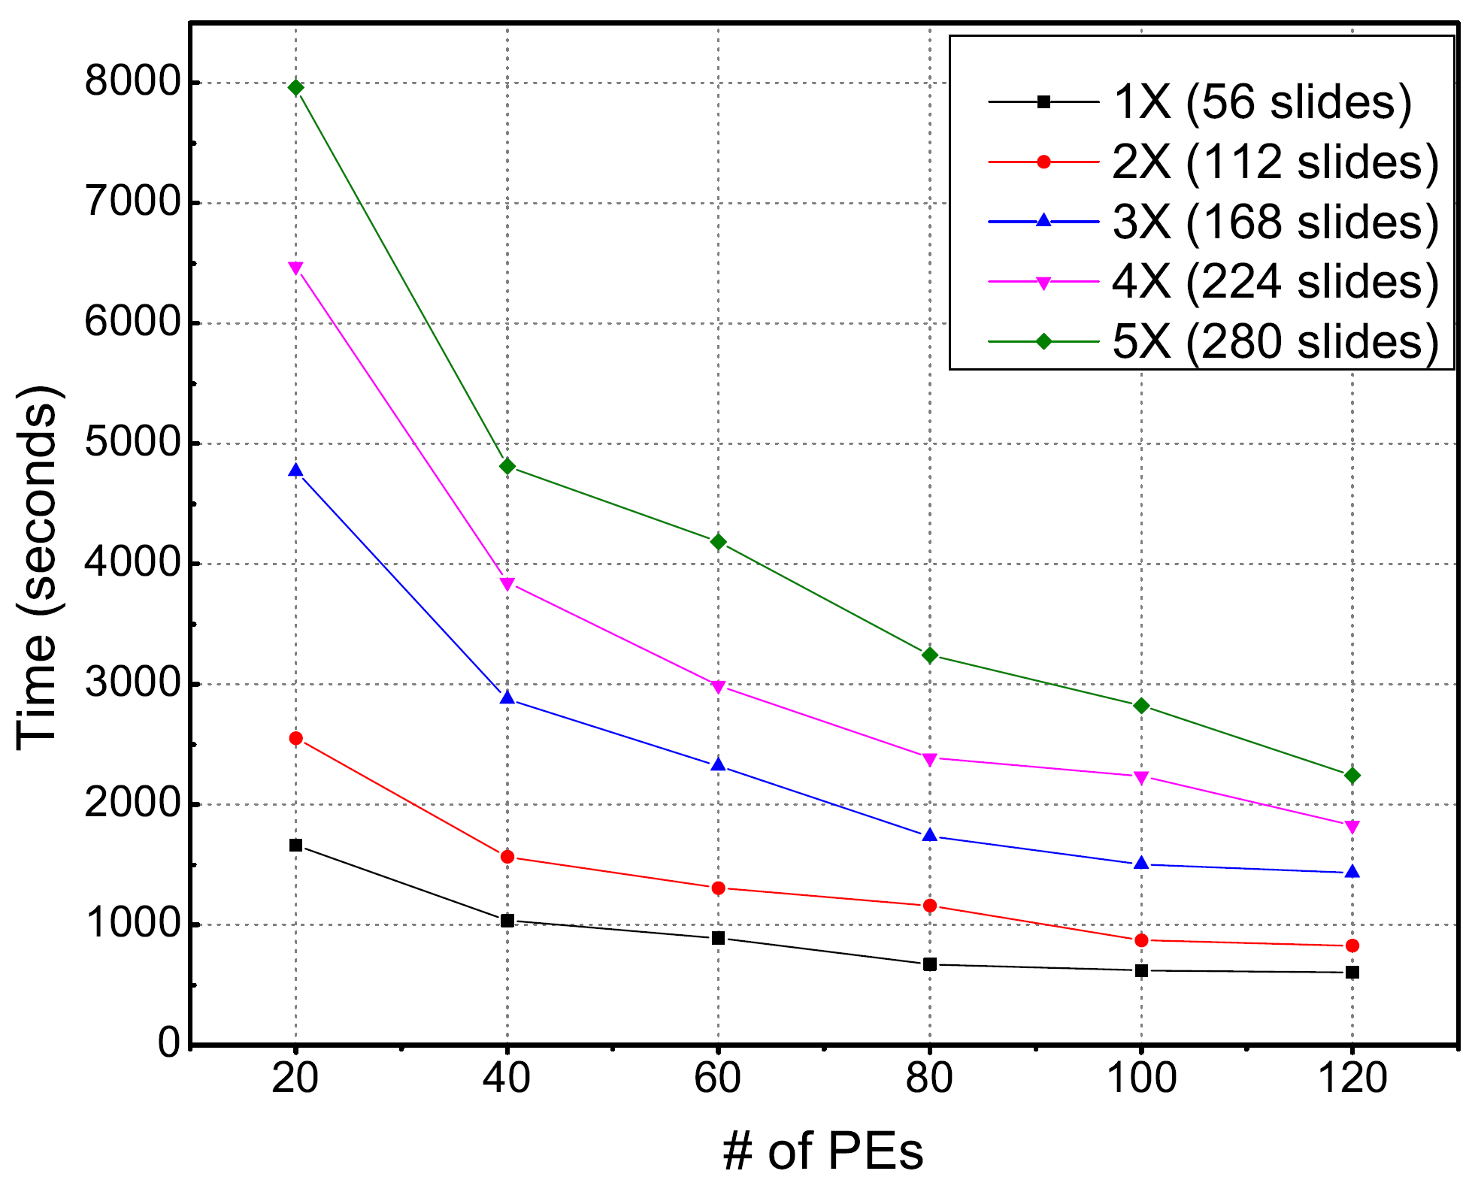
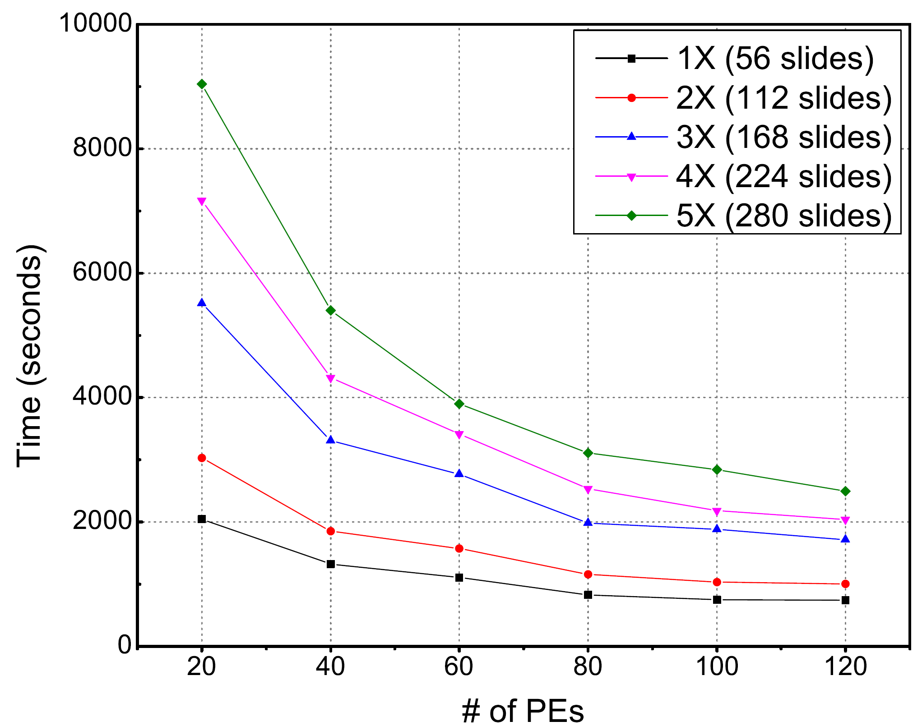
System Performance: NN
NN with Voronoi
NN with AABB tree
Performance
Notes:
Hadoop-GIS shows nice scalability as well.
We see scalable query performance with increasing number of reducers, and increasing size
of datasets. The first one is for OpenStreetMap dataset, and the second one is for imaging data with
Datasets of different sizes.
The boundary normalization overhead is a small fixed fraction of the overall cost.
The average querying time per image is 15 seconds (with 1X dataset and all cores), comparing with 22 minutes 12 seconds in a single partition postGIS, and 89 minutes 30 seconds on a single partition SDBMS X.

Slide 22
On-going Work
More experiments
Task profiling: I/O, memory, CPU, Network
GPU integration for 3D geometry computation
Move platform from Hadoop to Spark
RDMA integration
Summary
Notes:
Hadoop-GIS shows nice scalability as well.
We see scalable query performance with increasing number of reducers, and increasing size
of datasets. The first one is for OpenStreetMap dataset, and the second one is for imaging data with
Datasets of different sizes.
The boundary normalization overhead is a small fixed fraction of the overall cost.
The average querying time per image is 15 seconds (with 1X dataset and all cores), comparing with 22 minutes 12 seconds in a single partition postGIS, and 89 minutes 30 seconds on a single partition SDBMS X.

Slide 23
Thank you!

